Slide 1
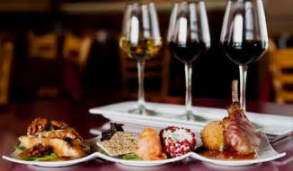
Food and Wine Pairing

Slide 2
“Cooking is simply a balance of fat, acid, salt and sweet.”

Slide 3
Complementary or Congruent
A great food and wine pairing creates a balance between the components of a dish and the characteristics of a wine. Simplify each dish into basic tastes and then seek a wine using either complementary or congruent pairing.
Complementary - Creates balance by contrasting flavours
Ie. sweet and salty, acid and fat
Congruent -Creates balance by harmonizing compatible flavours
Ie. creamy sauce with creamy wine like Chardonnay

Slide 4
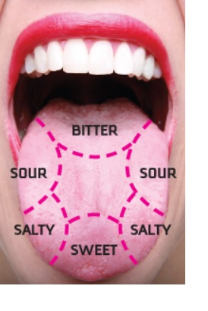
Where Do We Taste on our Tongue?

Slide 5
Basic Food and Wine Pairing Rules
-Acidic wines needs acidic food (anything you can squeeze a lemon on)
-Tannins need fat
-Wine should be as sweet or sweeter than the food.
-Wine should have the same flavor intensity as the food.
-Red wines pair best with bold flavored meats (red meat).
-White wines pair best with light intensity meats (fish or chicken).
- Heat needs sugar, pair spicy foods with sweet wines
- Pair with the dominant flavour, consider the sauce rather than the meat
-Champagne goes with everything

Slide 6
What comes First, the Wine or the Food?
Whatever sparks your creativity
Choose a dish and then base your wine off of that
Or
Choose a wine and then base your food off of that

Slide 7
Food and Wine Taste Interactions
Food Friendly
Acidity in Food
Increases body, sweetness and fruitiness in the wine
Decreases the acidity in the wine
Example: High acid food, dish with lemon with a high acid wine like Sauvignon Blanc
Salt in Food
Increases the body in the wine
Decreases the bitterness and acidity in the wine
Example: A salty food like blue cheese with a high acid wine like Riesling or a salt and pepper crusted steak with a tannic Cabernet Sauvignon

Slide 8
Food and Wine Taste Interactions
High Risk Foods
Sweetness in Food
Increases bitterness, acidity and burning effect of alcohol in the wine
Decreases body, sweetness and fruitiness in the wine
Example: a sweet food like glazed pears with a Moscato
Spice in Food
Increases bitterness, acidity and alcohol burn
Decreases the body, richness, sweetness and fruitiness in the wine
Example: A spicy food like chicken curry with a sweet, low alcohol Gewurztraminer

Slide 9
Food and Wine Taste Interactions
High Risk Foods
Bitterness in Food
Increases bitterness
Example: A red wine, like a full bodied Cab with chocolate
Umami in Food (think MSG)
Increases bitterness, acidity and alcohol burn
Decreases the body, sweetness and fruitiness in the wine
Example: A gamey red like Nebbiolo with mushrooms

Slide 10
High Risk Wines vs Low Risk Wines
High Risk Wines - Think big tannin structure, high acidity, high alcohol and complexity. The more structure and complexity of the wine, the more possible taste interactions and the more difficulty of pairing. However, these wines are the most rewarding when paired properly with food and wine.
Low Risk Wines - Think simple, unoaked, dry wines. Not going to be made unpleasant by a variety of dishes. However, not going to change very much either when matched with food, so not that interesting.

